Slide 1
The tutorial to build shared AI services --Session 2
Suqiang Song (Jack)
Director & Chapter Leader of Data/AI Engineering @ Mastercard
jackssqcyy@gmail.com
https://www.linkedin.com/in/suqiang-song-72041716/

Slide 2
Agenda
Session 2: Feb. 1rd Friday 10am-12pm PT
Module 3: AI Engineering platform and AI Engineers ( 40 mins)
Key factors to consider an AI Engineering platform
architect a data pipeline framework
Apache NiFi introduction
Traditional AI Tribe and its challenges
knowledges and skills are required for AI Engineer
Growing path for an AI Engineer
Module 4: Benchmark between Spark Machine learning and Deep learning + Code Lab 2 (30 mins)
Traditional Collaborative Filtering approach with Spark Mllib ALS (Scala)
Build an NCF deep learning approach with Intel Analytic Zoo on Spark (Scala)
Live Demo (40 mins)
Build an end to end AI Pipeline with Kafka, NiFi, Spark Streaming and Keras on Spark
Q & A (10 mins)

Slide 3
Course Prerequisites
Install Docker at your local laptop
Download two Docker images from shared drive URL kafka.tar and demo-whole.tar and also demo_pipeline.xml
passcode : jack
Load images to your Docker environment
https://1drv.ms/f/s!AsXKHMXBWUIBiBpaYk9FFjdoUifg
$ docker load -i kafka.tar
$ docker load -i demo-whole.tar

Slide 4
Module 3

Slide 5
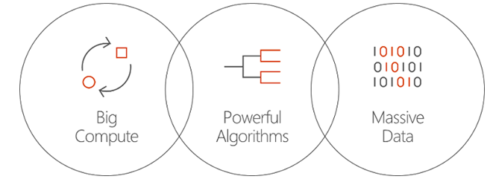
Key factors to consider an AI Engineering platform
Technology infrastructure
Talent
Data
Leverage
Automate
Consolidate
API/ Pipeline Enablement
AI Engineering
Organization/Process

Slide 6
Continue
Predefined Serving APIs & Templates
AI Engineering platform
Real Time
Serving
Streaming
Serving
Batch
Serving
ML /DL learning pipelines
Historical + Incremental
Serving Engine
Predefined AI Service Templates
Workbench
Machine Learning & Deep Learning Libs/Frameworks
Metrics
Admin
Data Pipeline Bus
Performance Analyzer
Data Pipeline Engine
Cloud Native
Predefined Integrated Pipelines
Real Time
Event Integration
Business Rule
Integration
Batch
Data Integration
Message
Bus
Online Systems
CRM
Files
Transfer
Data Lake
Monitoring
Data Sources

Slide 7
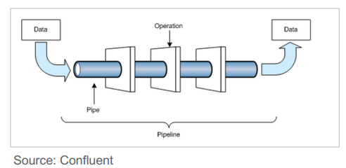

Data Flow Pipeline
Flow-based ”programming”
Source –Channel-Sink “structure”
Ingest Data from various sources and Transform data to various destinations
Extract – Transform – Load
High-Throughput, straight-through data flows
Data Governance
Combine Batch and Stream-Processing
Visual coding with flow editor
Event Processing (ESP & CEP)

Slide 8

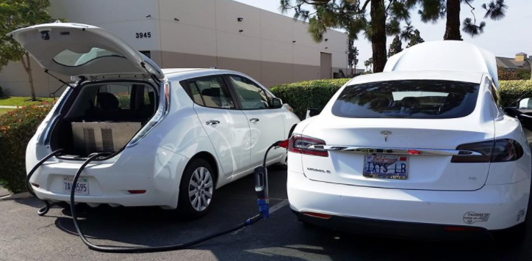
Architect a data pipeline framework
The X(quality attributes) for data pipeline framework includes
Clustering
High Availability & Recovery
Delivery Guarantee
Data Buffering ,Flow Control and Back Pressure
Data Governance
Usability
Extensibility
Multi-Tenancy
Version Control & Deployment
Security
Monitoring & Diagnostic Capabilities
Integration Capabilities
Cloud Native
Performance , Latency and Throughputs
What is the DFX ?
Along with functional requirements, there are various quality attributes.
The difference in these attributes can make the product very different.
Such as Tesla and Leaf
DFX is Design For Quality Attributes

Slide 9
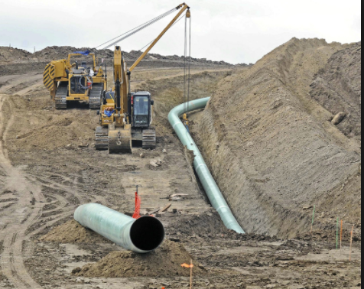
Example : High Availability and Recovery
High availability
Pipeline level : Each step or processor at flow that is likely to encounter failures will have a "failure" routing relationship
Pipeline Failure is handled by looping that failure relationship back on the same step or to new steps
Node level failover will depends on a "cluster coordinator" and a "primary node" elected
Pipeline failover between nodes ?
Recovery
Replay : Content repository should be designed to act as a rolling buffer of history which supports replay every well
Data Recovery after failover , the eventual consistency
Breakpoint resume : Last-saved offset , how you resume the pipeline from the broken pieces after fixed

Slide 10
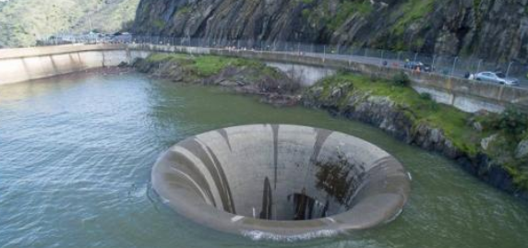
Example : Data Buffering ,Flow Control and Back Pressure
Buffering with Prioritization
Configure a prioritizer per connection, such as FirstInFristOut , NewestFirst,OldestFirst etc..
Determine what is important for your data – time based, arrival order, importance of a data set
Funnel many connections down to a single connection to prioritize across data sets
Develop your own prioritizer if needed
Flow Control & Back-Pressure
Configure back-pressure such as expiration, threshold for per connection
Based on number of flows or total size of flows
Upstream processor no longer scheduled to run until below threshold

Slide 11

Example : Security
Control Plane
Pluggable authentication :2-Way SSL, LDAP, Kerberos
File-based authority provider out of the box
Multiple roles to defines access controls
Data Plane
Optional 2-Way SSL between cluster nodes
Optional 2-Way SSL on Site-To-Site ( or Edge-to-Edge) connections
Encryption/Decryption of data through processors
Data privacy and compliance
PCI/PII compliance
GDPR (General Data Protection Regulation)
Yes , you don’t want your CEO to be testified before Congress ☺

Slide 12
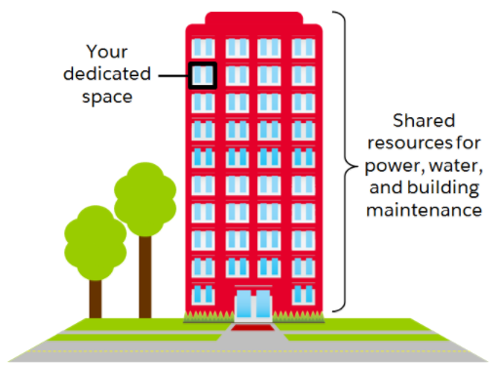
Example : Multi-Tenancy
Multi-tenant Authorization
Enable a self-service model for dataflow management, allowing each team or organization to manage flows with a full awareness of the rest of the flow, to which they do not have access.
Multi-tenant isolation and Separated SLA/QoS
Data is absolutely critical and it is loss intolerant
Enables the fine-grained flow specific configuration to each tenant
Data Buffering ,Flow Control and Back Pressure should be considered at tenant level
Multi-tenant isolated resources management
Integrate with 3rd popular resources management framework such as Yarn
Split up the functionalities of resource management and job scheduling/monitoring into separate daemons
Ability for multiple groups of entities (people or systems) to command, control, and observe state of different parts of the dataflow

Slide 13
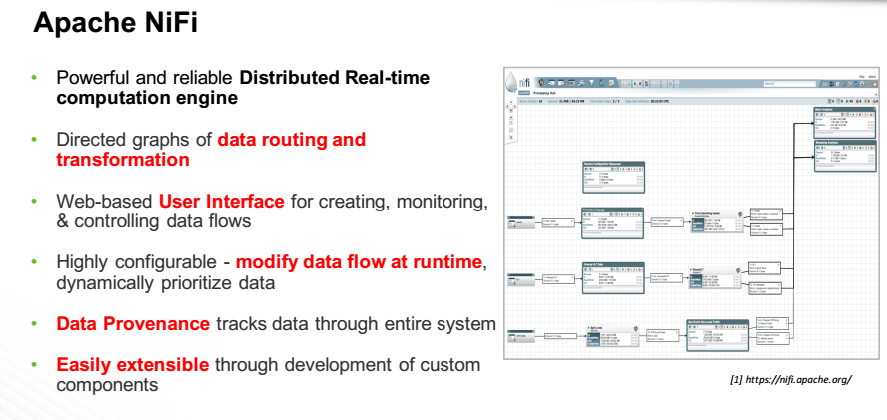

Slide 14
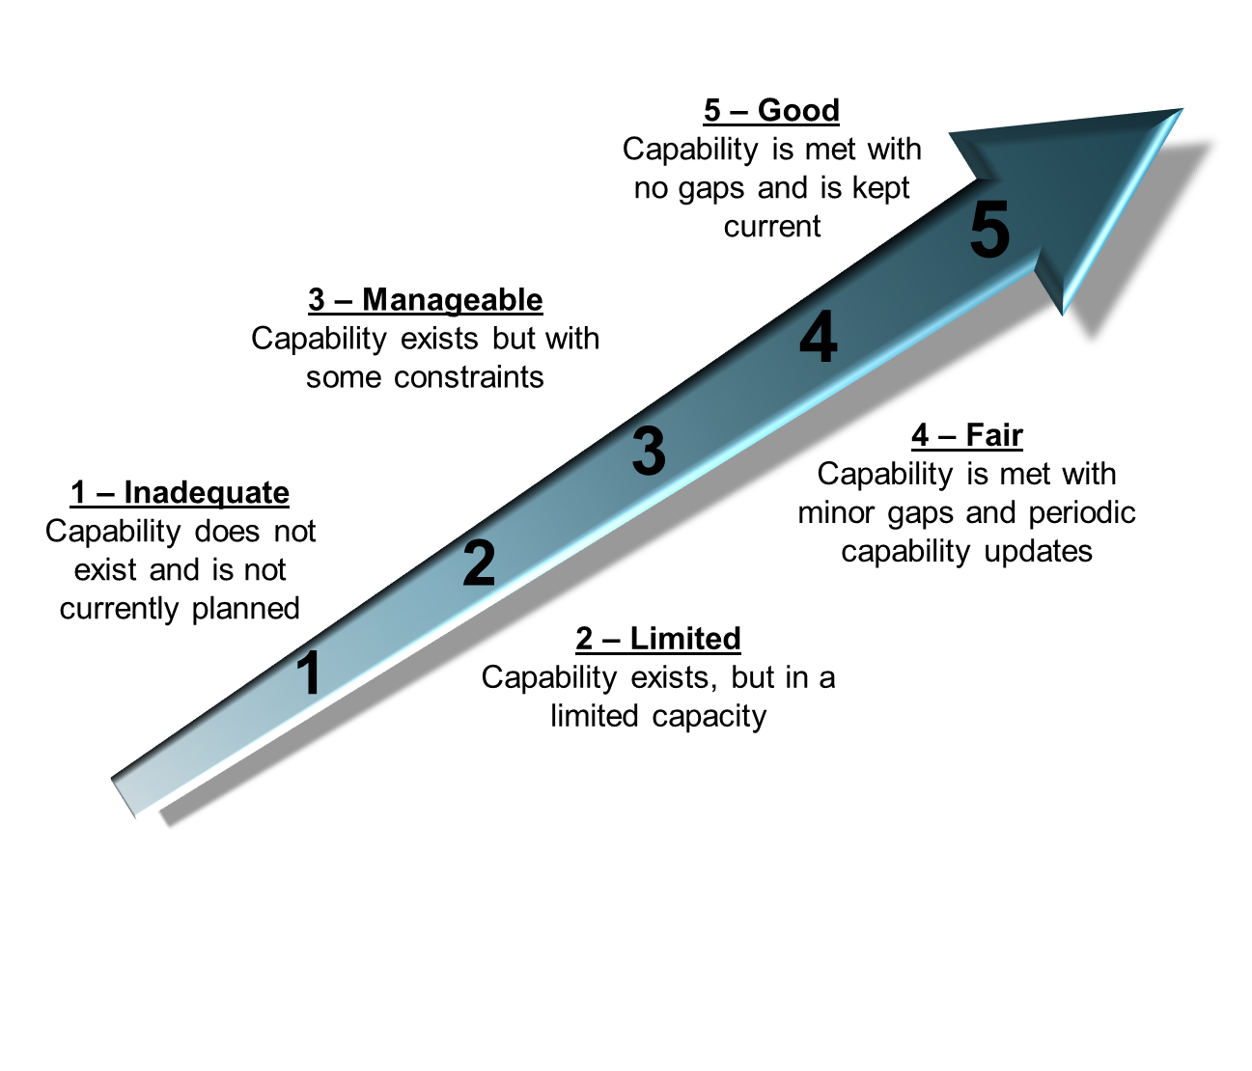
Technology Assessment Score Definition

Slide 15
Assessment Score Ratings
NiFi
N
Clustering
High Availability and Recovery
Delivery Guarantee
Data Buffering ,Flow Control and Back Pressure
N
N
N
N
1
2
3
4
5
1
2
3
4
5
1
2
3
4
5
1
2
3
4
5
Data Governance
Usability
Extensibility
Multi-Tenancy
N
N
N
N
1
2
3
4
5
1
2
3
4
5
1
2
3
4
5
1
2
3
4
5
Version Control & Deployment
Authentication & Authorization
Encryption and decryption
Monitoring & Diagnostic
N
N
N
N
1
2
3
4
5
1
2
3
4
5
1
2
3
4
5
1
2
3
4
5
Integration capabilities
Cloud Native
Performance, Latency and Throughputs (Real Time & Streaming)
Performance, Latency and Throughputs (Batch files / DB actions )
N
N
N
N
1
2
3
4
5
1
2
3
4
5
1
2
3
4
5
1
2
3
4
5

Slide 16

Traditional AI Tribe
Data Engineer
Architect how data is organized
& ensure operability
Output
Ingest
Deliver & Deploy Model
Understand Problem
Data Scientist
Deep analytics and modeling
for hidden insights
Communicate Results
Ingest Data
Business Analyst
Work with data to apply
insights to business strategy
Create and build Models
Explore and Understand Data
App Developer
Integrates data & insights with
existing or new applications
Analyze
Evaluate Data
Clean and Shape Data
Transform

Slide 17
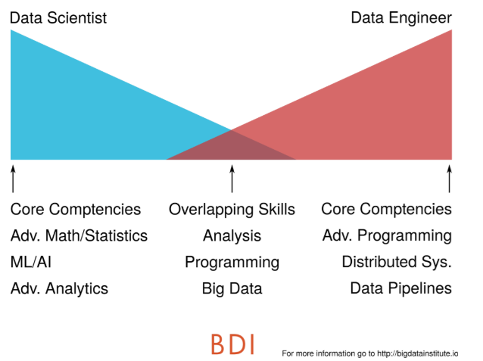
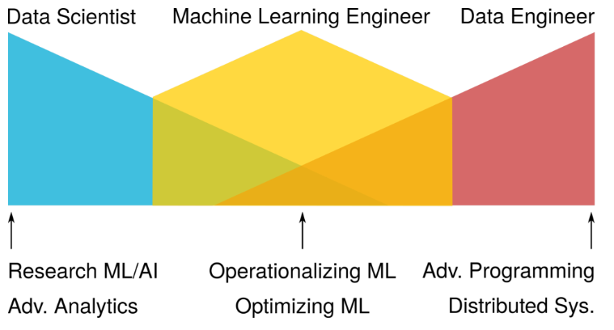
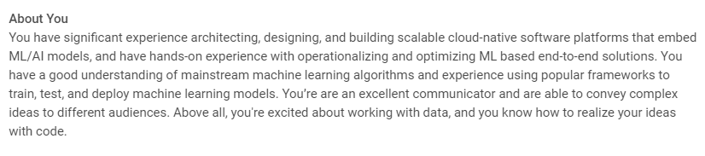
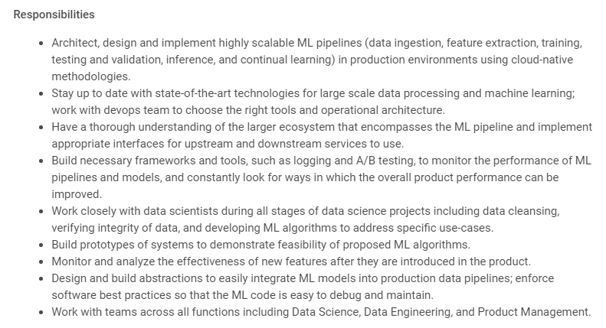
Trends
https://vmware.wd1.myworkdayjobs.com/VMware/job/USA-California-Palo-Alto/Staff-Machine-Learning-Engineer_R1813174?from=timeline

Slide 18
Ratings for traditional data scientist
Data Mining
Programing / Coding
Languages
Data Engineering
APIs /Services/App ( Model Serving)
Big Data Stacks

Slide 19
Ratings for traditional data engineer
Data Mining
Programing / Coding
Languages
Data Engineering
APIs /Services/App ( Model Serving)
Big Data Stacks

Slide 20
Ratings for traditional application developer
Data Mining
Programing / Coding
Languages
ML Framework
Data Engineering
APIs /Services/App ( Model Serving)
Big Data Stacks

Slide 21
Ratings for modern AI engineer
Data Mining
Programing / Coding
Languages
Data Engineering
APIs /Services/App ( Model Serving)
Big Data Stacks

Slide 22
Growing path 1 : traditional data scientist - > AI Engineer
Areas need enhancements
Training / Improving approach
AI Engineer
Programming / Coding
Programing Course or Hands on project , no need a CS Master
Languages
Java/ Scala ++ ,Python +
Deep Learning
To be expert , from bottom to the top
Data Engineering
Use Deep Learning to avoid the gap
Big Data Stacks
Spark ***** Hadoop ***
6 months certificate Plus
Model Serving
API /Application Design and implement Essentials

Slide 23
Growing path 2 : traditional data engineer - > AI Engineer
Areas need enhancements
Training / Improving approach
AI Engineer
Secondary DS/BA Master
At least 6 months certificate
Use Deep Learning to simply
Data Mining
Languages
Java/ Scala + ,Python +,R ++
ML Framework
Deep Learning
Fast.ai ,GitHub , Kaggle, Coursera /Udemy
At least 6 months DL certificate
Model Serving
API /Application Design and implement Advanced
Visualization & Communication
Visualization , Communication Skills Presentation

Slide 24
Growing path 3 : traditional application developer - > AI Engineer
Areas need enhancements
Training / Improving approach
AI Engineer
Secondary DS/BA Master
At least 6 months certificate
Use Deep Learning to simply
Data Mining
Languages
Python +++, R ++
ML Framework
Deep Learning
Fast.ai ,GitHub , Kaggle, Coursera /Udemy
At least 6 months DL certificate
Data Engineering
ETL Essentials
Data Pipeline ++
Use Deep Learning to avoid the gap
Big Data Stacks
Hadoop + Spark Essentials At least 6 months certificate
Visualization & Communication
Visualization , Communication Skills Presentation

Slide 25
Module 4+ Code Lab2
https://github.com/jack1981/AaaSDemo

Slide 26
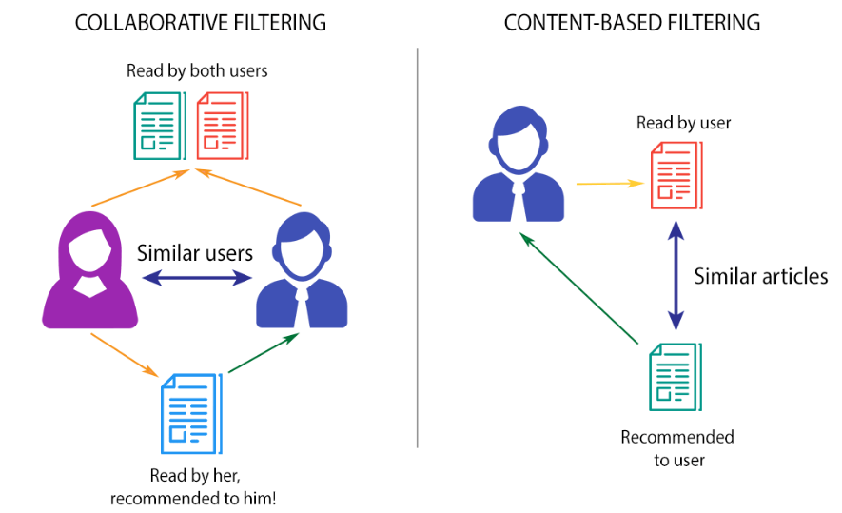
Collaborative Filtering -- concept

Slide 27
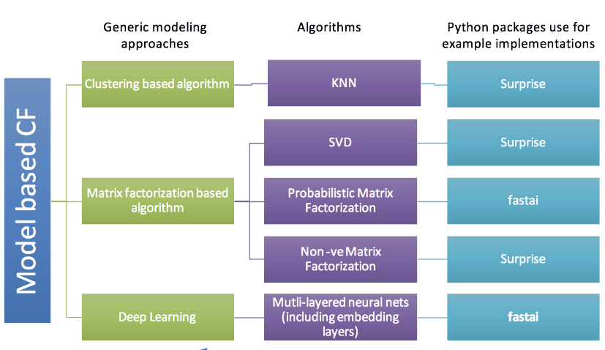
Collaborative Filtering -- Model selection
Spark Mllib
KMeans
Spark Mllib
ALS
NCF on Spark

Slide 28
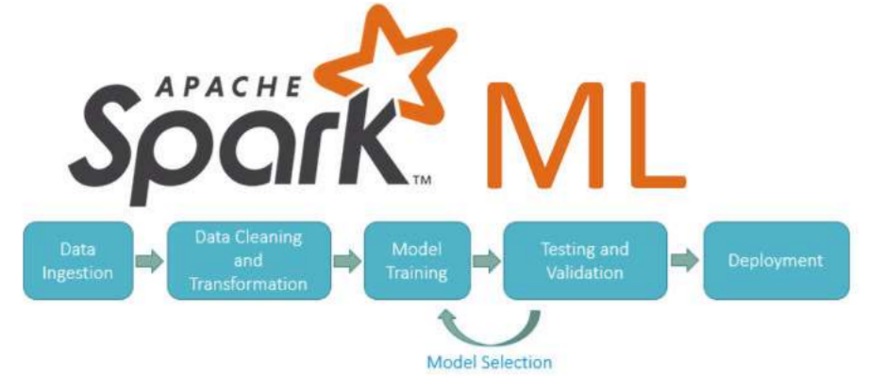
Spark Mllib
Enables Parallel, Distributed ML for large datasets on Spark Clusters
Offers a set of parallelized machine learning algorithms for ML
Supports Model Selection (hyper parameter tuning) using Cross Validation and Train-Validation Split.
Supports Java, Scala or Python apps using Data Frame-based API

Slide 29
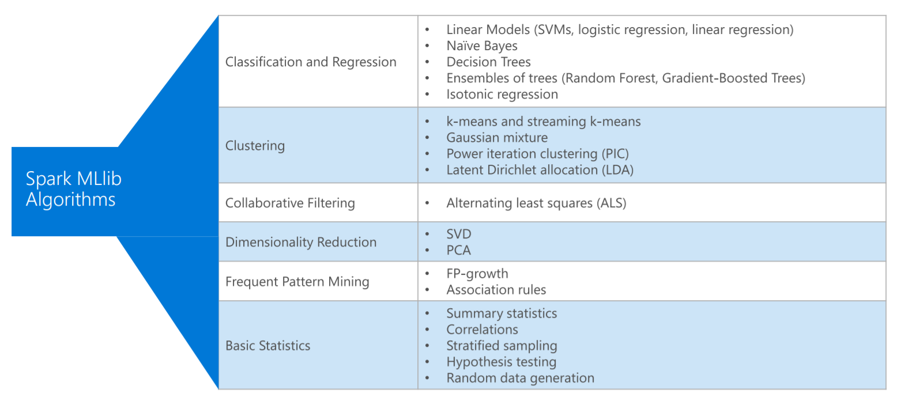
Spark Mllib Algorithms

Slide 30
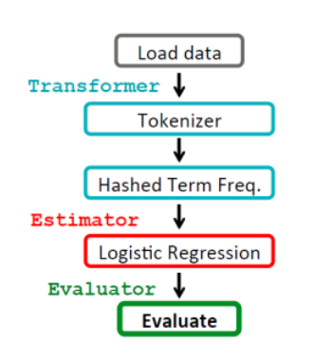
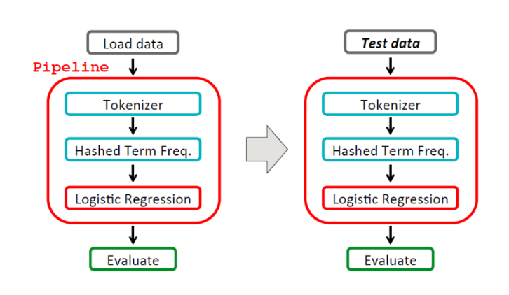
Spark Mllib ML Pipeline
DataFrame: Spark ML uses DataFrame rather than regular RDD as they hold a variety of data types (e.g. feature vectors, true labels, and predictions).
Transformer: a transformer converts a DataFrame into another DataFrame usually by appending columns. (since Spark DataFrame is immutable, it actually creates a new DataFrame). The implement method for a transformer is “transform()”.
Estimator: An Estimator is an algorithm which can be fit on a DataFrame to produce a Transformer. Implements method fit() taking a DataFrame and a model (also a transformer) as input.
Pipeline: Chains multiple Transformers and Estimators each as a stage to specify an ML workflow. These stages are run in order, and the input DataFrame is transformed as it passes through each stage.
Parameter: All Transformers and Estimators now share a common API for specifying parameters.
Evaluator: Evaluate model performance. The Evaluator can be
RegressionEvaluator for regression problems,
BinaryClassificationEvaluator for binary data, or
MulticlassClassificationEvaluator for multiclass problems.

Slide 31
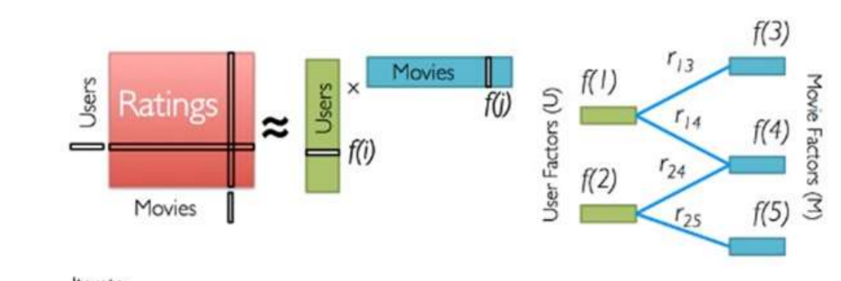
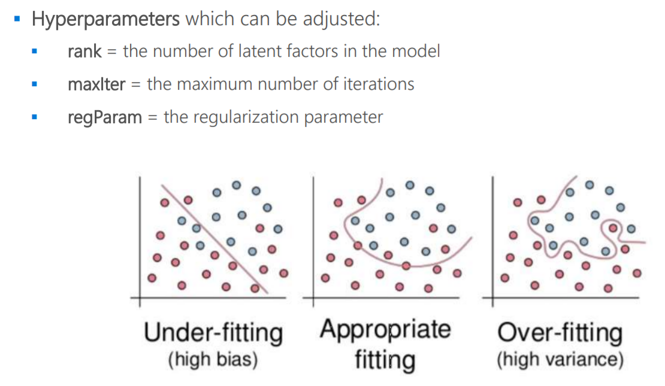
Alternating Least Squares (ALS) Spark ML

Slide 32
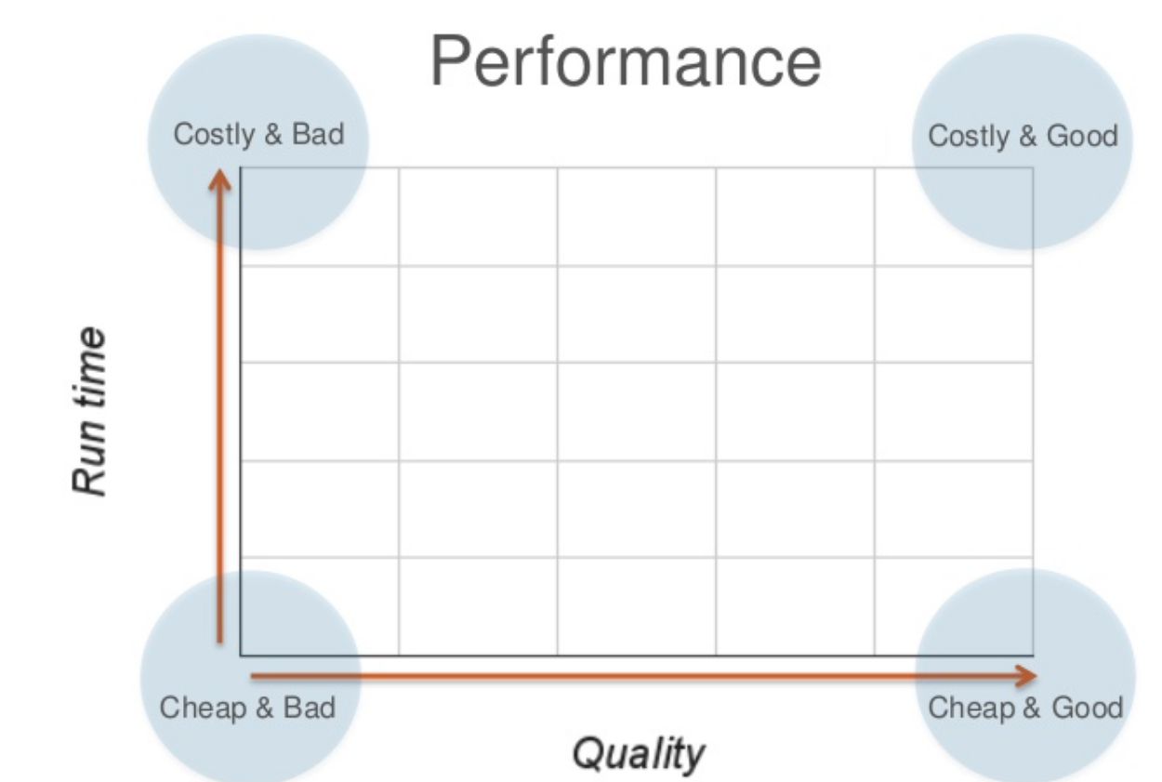
Collaborative Filtering -- Trade Offs
Cluster +MF Based
MF Based
Cluster Based
Deep Learning (CPU)

Slide 33
Code Time !

Slide 34
Live Demo (Build an end to end AI Pipeline with Kafka, NiFi, Spark Streaming and Keras on Spark)

Slide 35
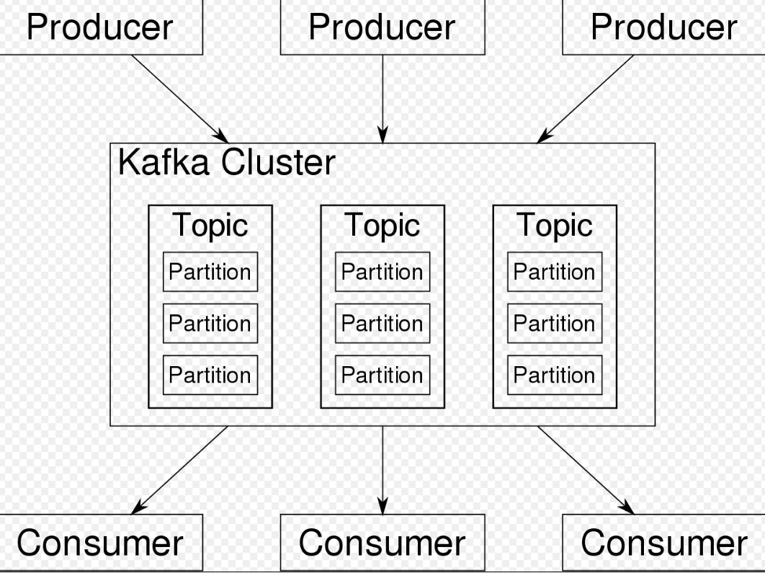
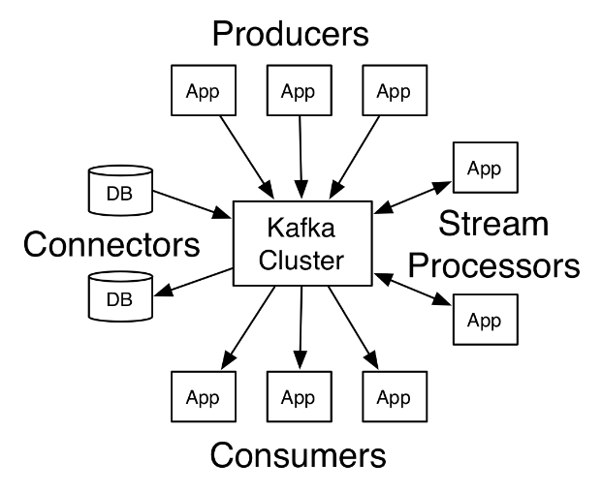
Kafka

Slide 36
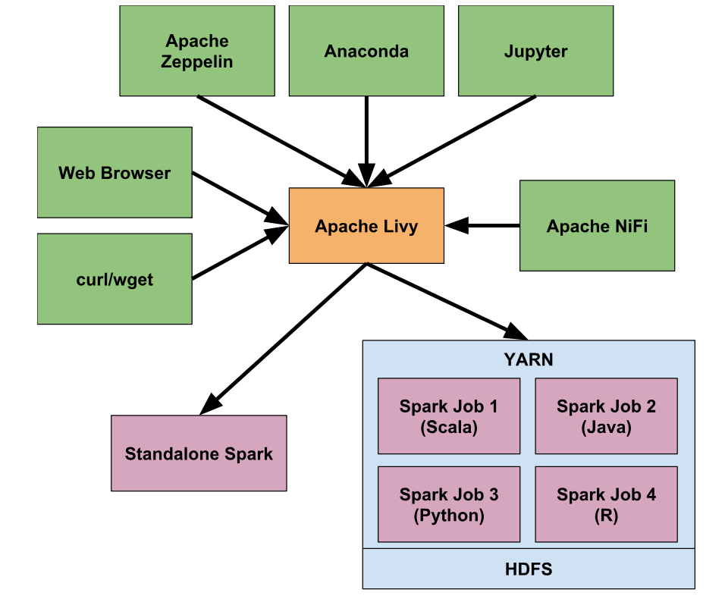
Livy

Slide 37
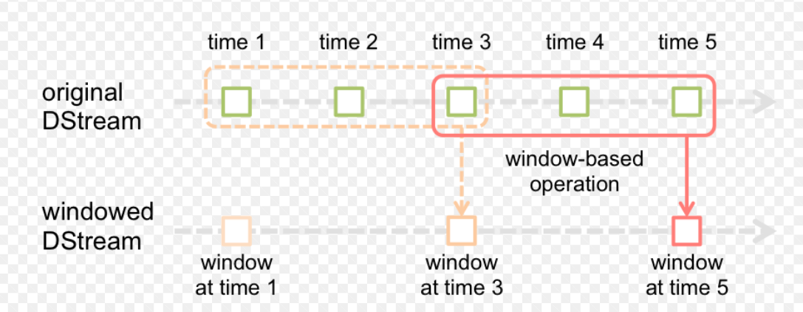
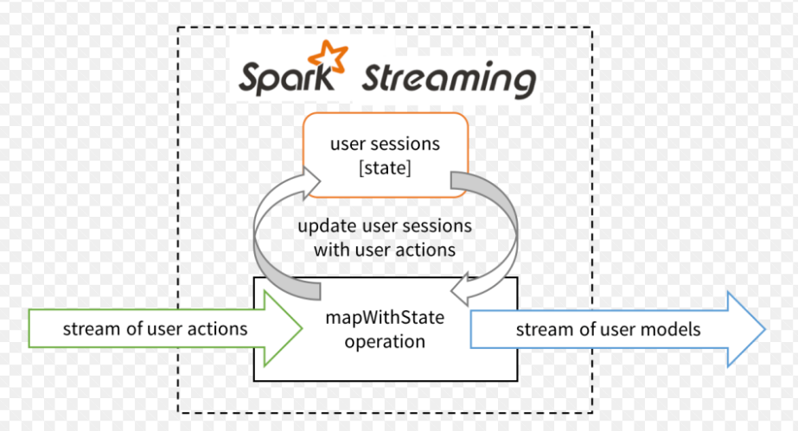
Spark Streaming

Slide 38
Q & A

